Slide 1
UzABSA: Aspect-Based Sentiment Analysis for the Uzbek Language
Matlatipov Sanatbek
Mersaid Aripov, Jaloliddin Rajabov, and Elmurod Kuriyozov
National University of Uzbekistan named after Mirzo Ulugbek
21 May 2024
Notes:
1 - Welcome to my final year project presentation.
2 – I am Aleix Nieto Juscafresa and the title of the Project is “An introduction to explainable artificial intelligence with LIME and SHAP”.
3 – I have been supervised by Dr. Albert Clapés & Dr. Sergio Escalera.

Slide 2
Contents
Introduction
Machine learning
Review(Uzbek NLP)
Purpose
Shared Tasks & Annotation
Evaluations & Conclusion

Slide 3
Introduction Uzbek Language(I-III) Review(Uzbek NLP) Purpose Shared tasks & Annotation Evaluation & Conclusion
INTRODUCTION
fine-grained approach to sentiment analysis that goes beyond determining the overall sentiment of a text. It identifies and extracts specific aspects or features mentioned in a text and determines the sentiment expressed towards each aspect.
Aspect-Based Sentiment Analysis (ABSA)
Sentiment analysis is a crucial tool for understanding public opinion and making data-driven decisions in various fields such as marketing, customer service, and social media monitoring.
Despite its importance, there is a lack of sentiment analysis resources for many underrepresented languages, including Uzbek.
Developing ABSA resources for Uzbek not only helps in better understanding sentiments expressed in this language but also promotes inclusivity in natural language processing (NLP) research, ensuring that the benefits of these technologies are accessible to speakers of all languages.

Slide 4
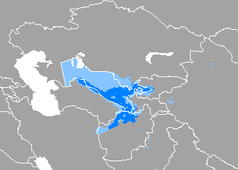
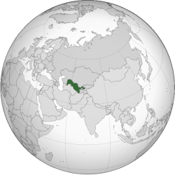
Introduction Uzbek Language(I-III) Review(Uzbek NLP) Purpose Shared tasks & Annotation Evaluation & Conclusion
Uzbek Language I
Not enough work done
Low-Resource(NLP resources) ≠ low density
Our Language is Uzbek
Official language of Uzbekistan
Native to All CA Countries, Afghanistan, Russia, Xinjiang(China)
Spoken by 37 million (as of 2024)

Slide 5
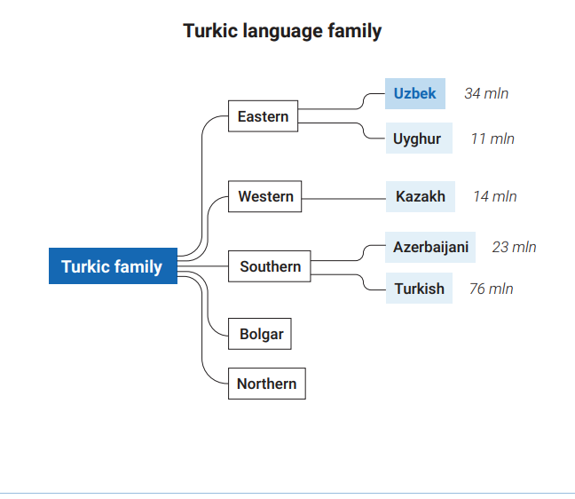
Introduction Uzbek Language(I-III) Review(Uzbek NLP) Purpose Shared tasks & Annotation Evaluation & Conclusion
Uzbek Language II
It is an eclectic mixture of Turkic, Persian, and Arabic
Uzbek (along with Uyghur) can be considered the direct descendant of Chagatai, the language of great Turkic Central Asian literary development in the realm of Chagatai Khan, Timur (Tamerlane), and the Timurid dynasty (including the early Mughal rulers of the Mughal Empire).
Unlike other Turkic languages, vowel harmony is almost completely lost in modern Standard Uzbek, though it is still observed to some degree in its dialects, as well as in Uyghur.
https://en.wikipedia.org/wiki/Uzbek_language
* The picture is taken from here

Slide 6
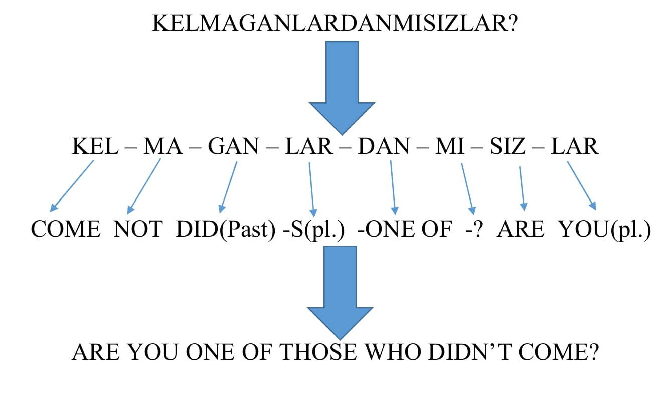
Introduction Uzbek Language(I-III) Review(Uzbek NLP) Purpose Shared tasks & Annotation Evaluation & Conclusion
Uzbek Language III
Turkic Family
Null Subject
No Articles
No Gender
Subject-object-verb

Slide 7
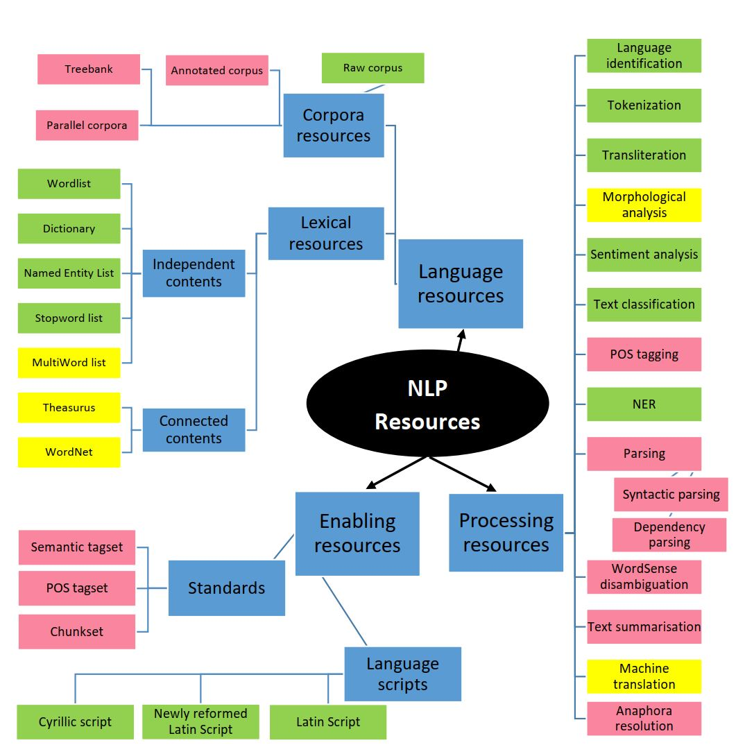
Introduction Uzbek Language(I-III) Review(Uzbek NLP) Purpose Shared tasks & Annotation Evaluation & Conclusion
Uzbek NLP progress
* Overall contributers: Sh.Nazirov, А. Po’latov, O’.Xamdamov, S.Qobilov(SamDU) va M.Musaevlar
* Dictionaries, synsets, and stopwords. The book of Uzbek dictionary words in both Latin and Cyrillic scripts [Tog’ayev et al.(1999)], WordNet type synsets data [Agostini et al.(2021)], and WordNet type thesaurus datasets [Aripov(2018)]. Automatic detection of stopwords in Uzbek has been proposed by Madatov et. al. [Madatov et al.(2022)].
* Language identification, and Tokenization - (both sentence-level and word-level) are general tasks that, once done, can easily include the majority of languages at once. Moreover, [Bakaev, Ilkhom. (2021). Tokenization task]
* Written scripts and machine transliteration - [Mansurov and Mansurov(2021a)] propose a tool based on decision tree to transliterate between Cyrillic and Latin scripts. Recent work from [Salaev et al.(2022a), Kuriyozov, and G ́omez-Rodr ́ıguez] worked on machine transliteration.
* Morphological Analysis(MA). The first works on Uzbek morphological analyzers was done using the rule-based method[Matlatipov and Vetulani(2009)]. The Apertium-Uzb monolingual package also has the biggest available annotated wordlist for Uzbek. [Nilufar Abdurakhmonova & Tuliyev have paper on FST based MA.]
* Text Classification. [Ignatev N.A., Tuliyev U.] worked on creating patterns from NLWords based on text(document).
* Machine Translation: [Aripov, Khakimov M., Matlatipov S.,, Abdurakhmonova N., Allaberdiyev B., Altynbek Sharipbay]
* Sentiment Analysis: [Aripov Mersaod, Matlatipov Sanatbek, Kuriyozov Elmurod, Rabbimov Ilyos, Kobilov Sami]
NO ABSA resource for Uzbek language

Slide 8
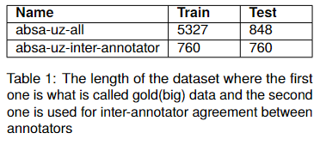
Introduction Uzbek Language(I-III) Review(Uzbek NLP) Purpose Shared tasks & Annotation Evaluation & Conclusion
Purpose
The first annotated dataset for aspect-based sentiment analysis in the Uzbek language comprises reviews sourced from the domain of Uzbek restaurants which was pre-processed as well as cleaned from our previous work(Matlatipov et al., 2022).
Annotation guideline has been developed for annotators
Evaluated the dataset using inter-annotator agreement using Cohen’s Kappa, Krippendorff’s α as well as classification model, namely K-Nearest Neighbour (KNN).
* The work inspired by this work [SemEval-2014 Task 4: Aspect Based Sentiment Analysis](https://aclanthology.org/S14-2004) (Pontiki et al., SemEval 2014)

Slide 9
Introduction Uzbek Language(I-III) Review(Uzbek NLP) Purpose Shared tasks & Annotation Evaluation & Conclusion
Shared Tasks
Task1(T1) Aspect term extraction: Given a set of sentences with pre-identified entities (e.g., restaurants), identify the aspect terms present in the sentence and return a list containing all the distinct aspect terms. An aspect term names a particular aspect of the target entity.
Xizmat va xodimlar muomilasi menga yoqdi, ammo ovqat yamon ekan“("I liked the service and the staff, but the food").
Task2(T2) Aspect term polarity: For a given set of aspect terms within a sentence, determine whether the polarity of each aspect term is positive, negative, neutral or conflict (i.e., both positive and negative).
same example above: Xizmat va xodimlar muomilasi menga yoqdi, ammo ovqat yamon ekan“ === {xizmat: positive, xodimlar: positive, ovqat: negative
Task3(T3) Aspect Category detection: Given a predefined set of aspect categories (ovqat(food), xizmat(service), narxi(price), muhit(environment, atmosphere), and boshqa(misc.)), identify the aspect categories discussed in a given sentence. Aspect categories are typically coarser than the aspect terms of task 1, and they do not necessarily occur as terms in the given sentence.
Task4:Aspect category polarity: Given a set of pre-identified aspect categories (e.g., {food, price}), determine the polarity (positive, negative, neutral or conflict) of each aspect category.

Slide 10
Introduction Uzbek Language(I-III) Review(Uzbek NLP) Purpose Shared tasks & Annotation Evaluation & Conclusion
Annotation
We are given the corpus of reviews where our tasks are extracting Aspect Terms, Aspect Terms Polarities, Aspect Category Terms and Aspect Categories Polarities.

Slide 11
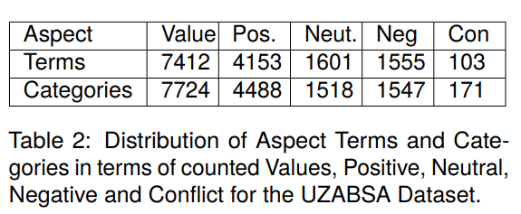
Introduction Uzbek Language(I-III) Review(Uzbek NLP) Purpose Shared tasks & Annotation Evaluation & Conclusion
Annotation
Two annotator is participated in the process where one of them is expert in linguistics.
Annotation guideline link(7 pages): https://docs.google.com/document/d/1juYoOn1h-zAvs4facFhzFw5KKkOfsM78/edit?usp=sharing&ouid=108484967563589516106&rtpof=true&sd=true
The last step is the conversion of annotation format-based datasets into other suitable formats, such as JSONL, XML, and Parquet, therefore making them accessible on the HuggingFace platform.
The annotation of each aspect term, together with its corresponding sentiment, is performed for every review sentence. Aspect categories are annotated using predefined five restaurant-related domain terms, and their polarities, namely positive, negative, neutral, and conflict.

Slide 12
Introduction Uzbek Language(I-III) Review(Uzbek NLP) Purpose Shared tasks & Annotation Evaluation & Conclusion
Evaluation
Above, the A confusion matrix (Figure 2) is illustrated for T2, T3 and T4 tasks, whereas, the T1 task has more than 650 classes, so we decided to skip the illustration.

Slide 13
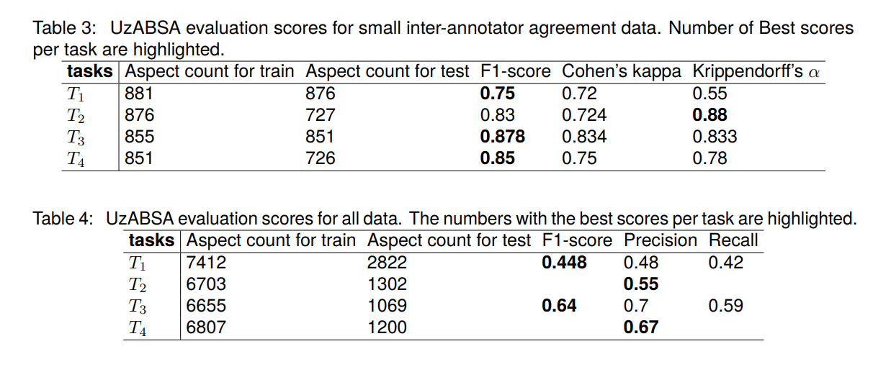
Introduction Uzbek Language(I-III) Review(Uzbek NLP) Purpose Shared tasks & Annotation Evaluation & Conclusion
Evaluation
Notes:
T1: F1-scores have been calculated by two annotators’ agreements where the comparison with 881 aspect terms for gold and 876 aspect terms for the test dataset. The result retrieved 75% F1-accuracy with 75.1% Precision as well as 74.6% Recall. Cohen’s Kappa score retrieved 72% accuracy whereas Krippendorffś alpha for nominal matrix retrieved 55%.
T2: Simple ratio accuracies have been calculated by two annotators’ agreements where comparison output 727 correctly annotated out of 876 aspect term polarities. The ratio accuracy performed 83%. Cohen’s Kappa score retrieved 72.4% accuracy whereas Krippendorffś alpha for nominal matrix retrieved 88%.
T3: F1-score have been calculated by two annotators’ agreements where the comparison with 855 aspect categories for gold and 851 aspect categories for the test dataset. The result retrieved 87.8% F1-accuracy with 88% Precision as well as 87.6% Recall. Cohen’s Kappa score retrieved 83.4% accuracy whereas Krippendorffś alpha for nominal matrix retrieved 83.3%.
T4: Simple ratio accuracies have been calculated by two annotators’ agreements where comparison output 726 correctly annotated out of 851 aspect category polarities. The ratio accuracy performed was 85.3%. Cohen’s Kappa score retrieved 75% accuracy whereas Krippendorffś alpha for nominal matrix retrieved 78%.

Slide 14
Introduction Uzbek Language(I-III) Review(Uzbek NLP) Purpose Shared tasks & Annotation Evaluation & Conclusion
Evaluation method(K-NN Implementation Steps)
Pre-processed, tokenized, stemmed(using our original idea) text data and applied stopwords.
Prepared feature vectors, e.g., TF-IDF word embeddings, for each data point.
Step 1: Data Preparation
Step 2: Choosing K
Selected an appropriate value for the number of neighbours, K.
chose K=5 as a starting point for demonstration purposes. K=5 means that for each data point, the model considered the five nearest neighbours for classification which helped the model’s performance and be determined through experimentation.
used techniques cross-validation to find the optimal K for the dataset.
Fit the K-NN model on the training data..
Step 3: Training

Slide 15
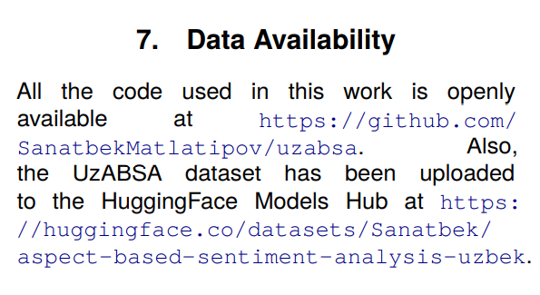
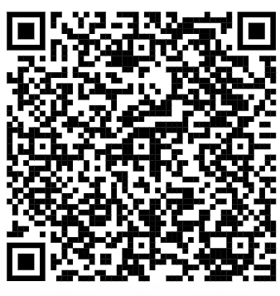
Introduction Uzbek Language(I-III) Review(Uzbek NLP) Purpose Shared tasks & Annotation Evaluation & Conclusion
Conclusion
In the work, we developed a corpora for Aspect-Based Sentiment Analysis (ABSA) specifically for the Uzbek language. We included four shared tasks and ensured reliable annotations by utilizing two annotators. (QR-code )
Evaluated the dataset using inter-annotator agreement using Cohen’s Kappa, Krippendorff’s α as well as classification model, namely K-Nearest Neighbour (KNN).

Slide 16
Introduction Uzbek Language(I-III) Review(Uzbek NLP) Purpose Shared tasks & Annotation Evaluation & Conclusion
Future work
Expanding the dataset to include more diverse sources and larger volumes of text(this part is almost ready ).
Exploring more advanced machine learning models, such as neural networks, to improve accuracy.
Conducting further error analysis to understand and mitigate common misclassifications.
Extending this approach to other underrepresented languages, fostering inclusivity in NLP research.

Slide 17
Introduction Uzbek Language(I-III) Review(Uzbek NLP) Purpose Shared tasks & Annotation Evaluation & Conclusion
Acknowledgment
This publication has been produced within the framework of the Grant “REP-25112021/113 - UzUDT: Universal Dependencies Treebank and parser for natural language processing on the Uzbek Language”, funded under the MUNIS Project, supported by the World Bank and the Government of the Republic of Uzbekistan. The statements do not necessarily reflect the official position of the World Bank and the Government of the Republic of Uzbekistan. Exploring more advanced machine learning models, such as neural networks, to improve accuracy.

Slide 18
THANK YOU VERY MUCH FOR YOUR ATTENTION
E’tiboringiz uchun RAHMAT!

